Slide 1
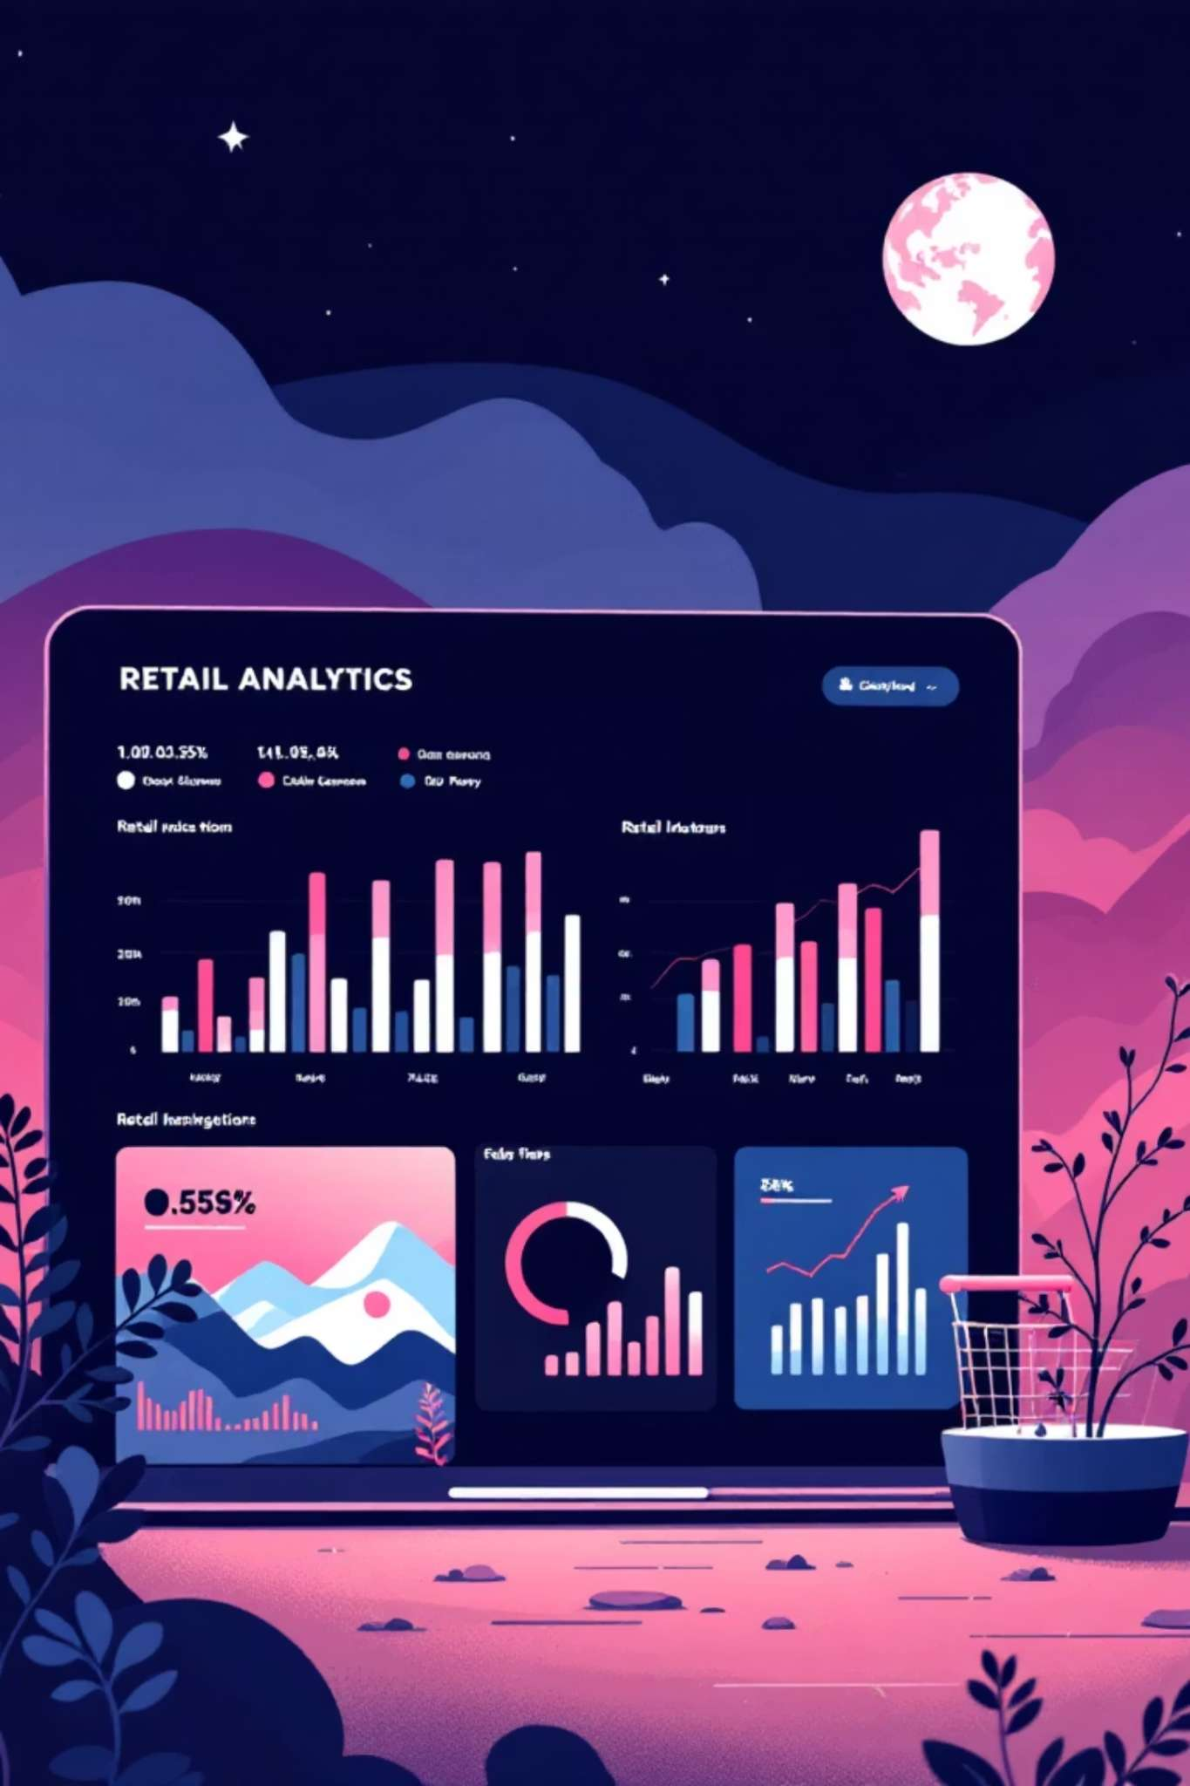
Customer Shopping Behavior Analysis
Uncovering insights from 3,900 purchases to drive strategic business decisions

Slide 2

Dataset Overview
3,900
18
Total Purchases
Data Columns
Transactions analyzed across all categories
Comprehensive customer and purchase attributes
50
25
Locations
Products
Geographic diversity in customer base
Items tracked across 4 major categories

Slide 3
Data Preparation Journey
01
02
Data Loading & Exploration
Cleaning & Standardization
Imported dataset using pandas, analyzed structure with df.info() and summary statistics
Handled 37 missing review ratings, standardized columns to snake_case format
03
04
Feature Engineering
Database Integration
Created age_group bins and purchase_frequency_days for deeper insights
Connected to PostgreSQL for advanced SQL analysis capabilities

Slide 4
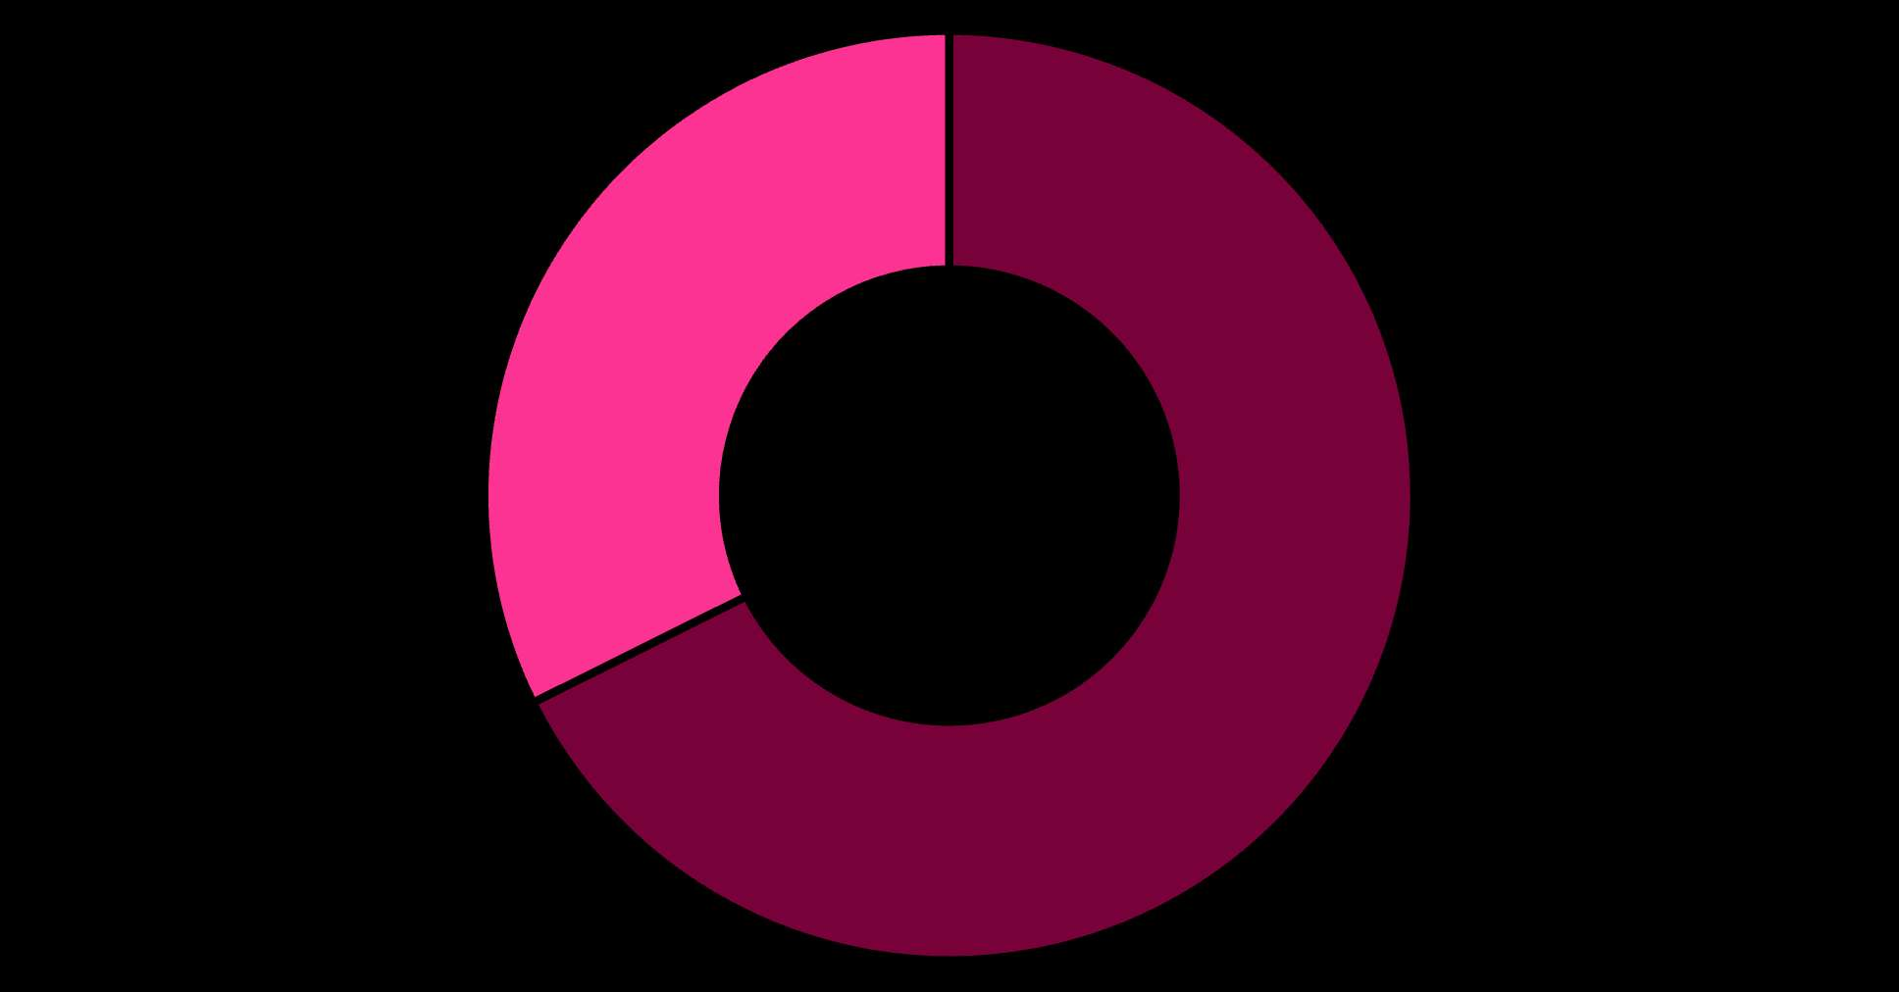
Revenue by Gender
Male Customers Drive Revenue
Male customers generate 68% of total revenue
Female segment shows opportunity for targeted growth campaigns
Male
Female

Slide 5


Smart Discount Users
839
21.5%
839
21.5%
High-Value Discount Shoppers
Segment Size
Customers using discounts while spending above average
Represents strategic customer group for retention
These customers prove discounts don't always mean lower margins—they're willing to spend more

Slide 6
Top-Rated Products
97%
96%
95%
Gloves
Sandals
Boots
Highest average rating: 3.86/5
Strong performance: 3.84/5
Customer favorite: 3.82/5
95%
94%
Hat
Skirt
Consistent quality: 3.80/5
Popular choice: 3.78/5

Slide 7
Customer Segmentation Insights
New (83)
Returning (701)
Loyal (3,116)
Subscription Status
1,053 subscribers averaging $59.49 spend
2,847 non-subscribers averaging $59.87 spend
Subscription opportunity: 958 repeat buyers (>5 purchases) not yet subscribed

Slide 8




Category Performance
Clothing
Footwear
Top sellers: Blouse, Pants, Shirt
Top sellers: Sandals, Shoes, Sneakers
Largest category with 1,737 purchases
Strong ratings across all items
Accessories
Outerwear
Top sellers: Jewelry, Sunglasses, Belt
Top sellers: Jacket, Coat
High-margin opportunity category
Seasonal demand patterns

Slide 9
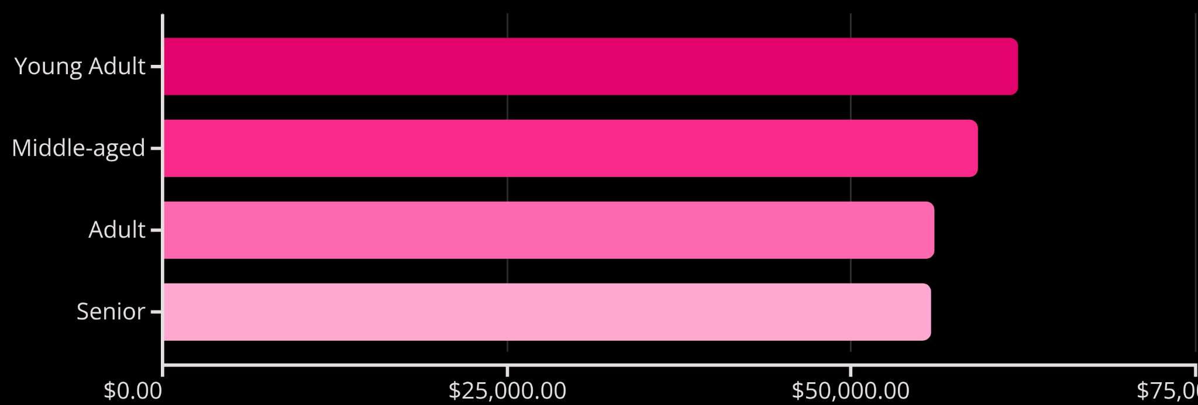
Revenue by Age Group
Young Adults lead revenue generation
Express shipping users spend $60.48 average vs. $58.46 standard
Balanced distribution across all age segments
Premium service correlates with higher spend

Slide 10
Strategic Recommendations
Boost Subscriptions
Loyalty Programs
Optimize Discounts
Target 958 repeat buyers with exclusive benefits—untapped revenue potential
Move 701 returning customers into loyal segment through rewards
839 high-spenders use discounts—balance promotions with margin control
Product Positioning
Targeted Marketing
Highlight top-rated items (Gloves, Sandals, Boots) in marketing campaigns
Focus on Young Adults and express shipping users for maximum ROI

